Slide 1
How I Spent My Summer “Vacation” in France at JSALT
Kenneth Church
Tuesday, June 27, 2023
https://github.com/kwchurch/JSALT_Better_Together
https://github.com/kwchurch/JSALT_Better_Together/blob/main/slides/June27/TownHall.pptx

Slide 2
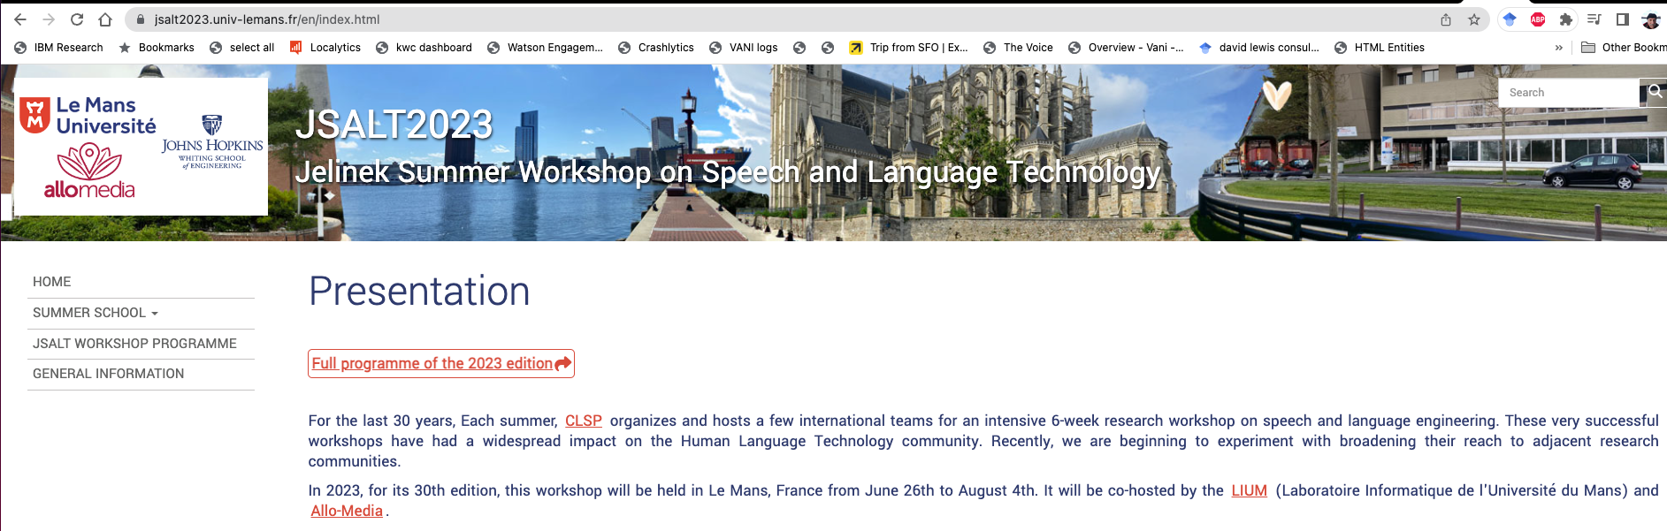
https://jsalt2023.univ-lemans.fr/en/index.html

Slide 3
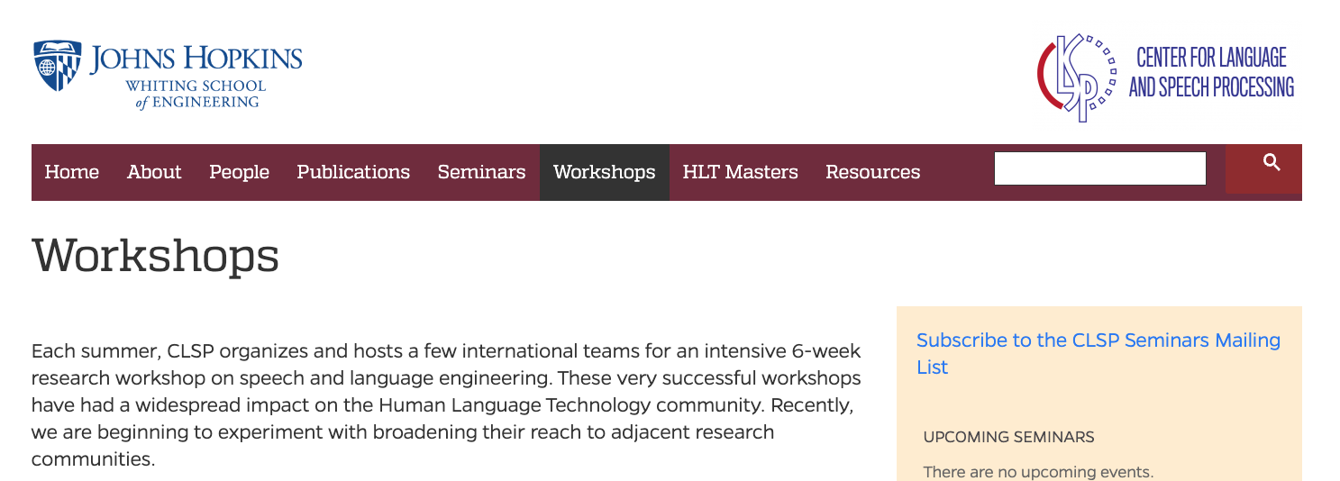
https://www.clsp.jhu.edu/workshops/

Slide 4

Better Together: Text (Titles, Abstracts, Body); Context (Citations)

Slide 5
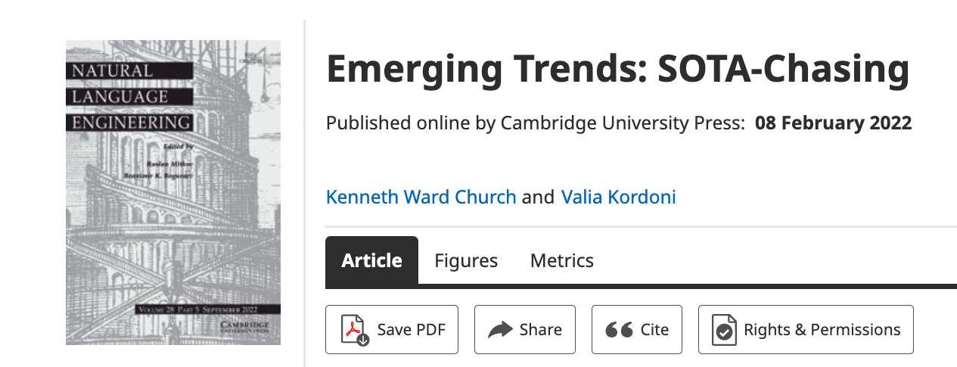
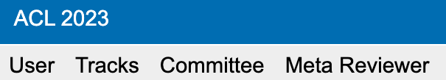

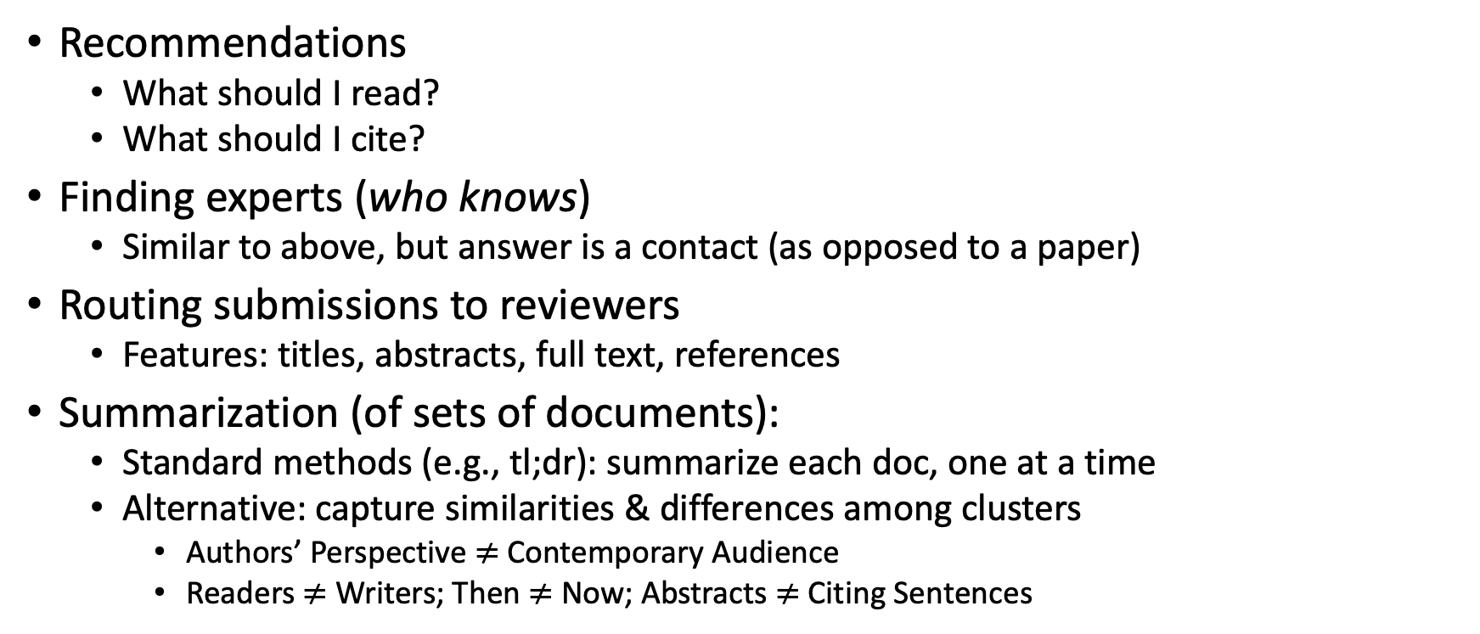
Document Similarities: Use Cases
Recommendations
What should I read?
What should I cite?
Finding experts (who knows)
Similar to above, but answer is a contact (as opposed to a paper)
Routing submissions to reviewers
Features: titles, abstracts, full text, references
Summarization (of sets of documents):
Standard methods (e.g., tl;dr): summarize each doc, one at a time
Alternative: capture similarities & differences among clusters
Authors’ Perspective $≠$Contemporary Audience
Readers $≠$ Writers; Then $≠$ Now; Abstracts $≠$ Citing Sentences

Slide 6
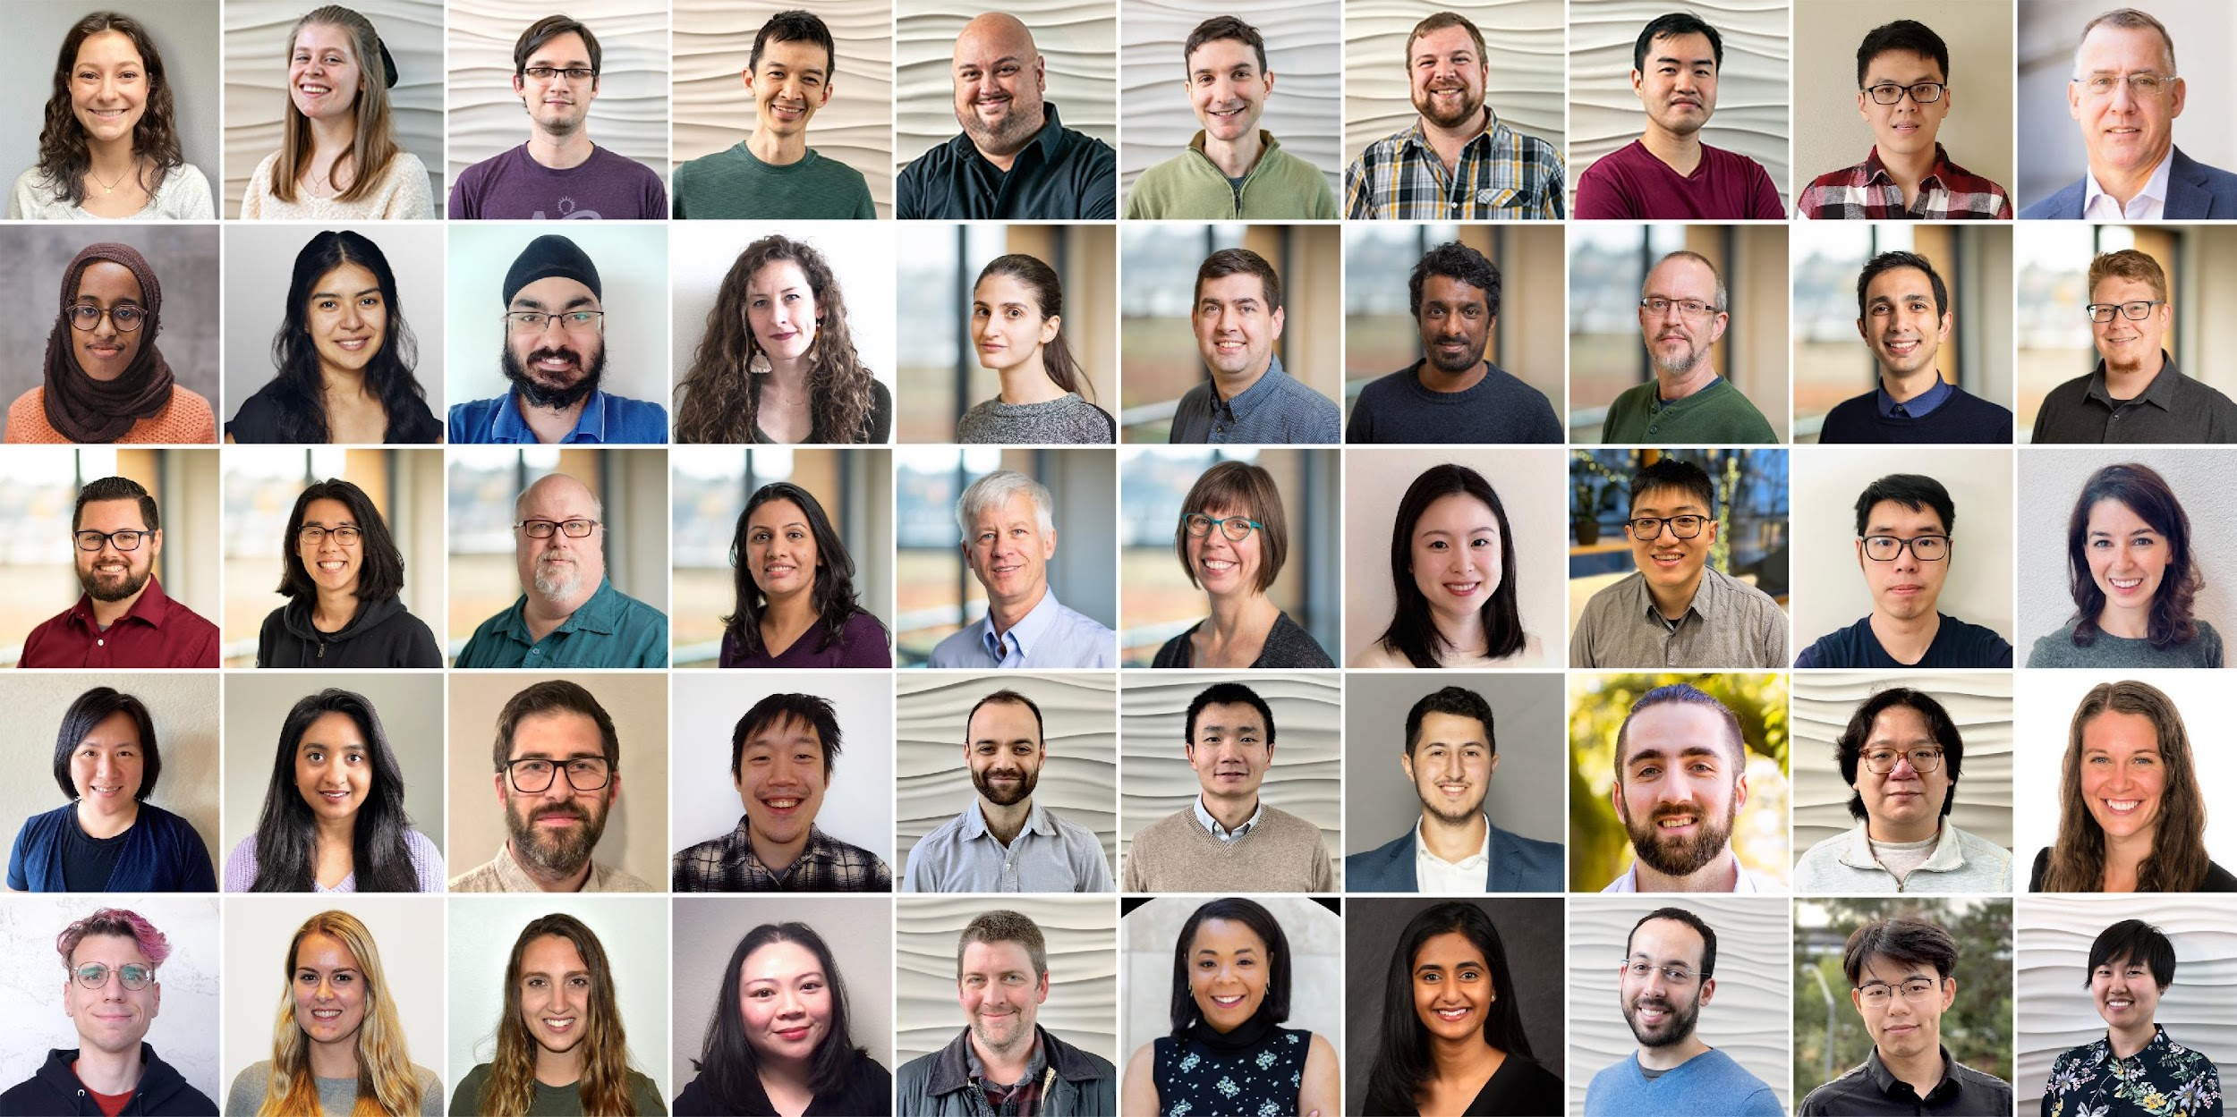
Semantic Scholar: Significant Effort (slide from Dan Weld)
50 person team
7 year project
207M+ scientific paper index
8M+ monthly active users

Slide 7
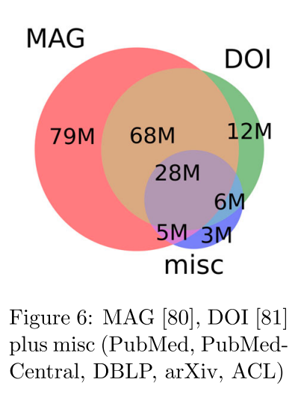
Semantic Scholar
Seven Sources
Fields of Study
Medicine (45M) | Engineering (8M) | Business (4M) | Geology (3M)
Chemistry (13M) | Physics (7M) | Sociology (3M) | History (2M)
Computer Science (13M) | Psychology (7M) | Geography (3M) | Art (2M)
Biology (13M) | Mathematics (5M) | Economics (3M) | Philosophy (1M)
Materials Science (10M) | Political Science (4M) | Environmental Science (3M)

Slide 8
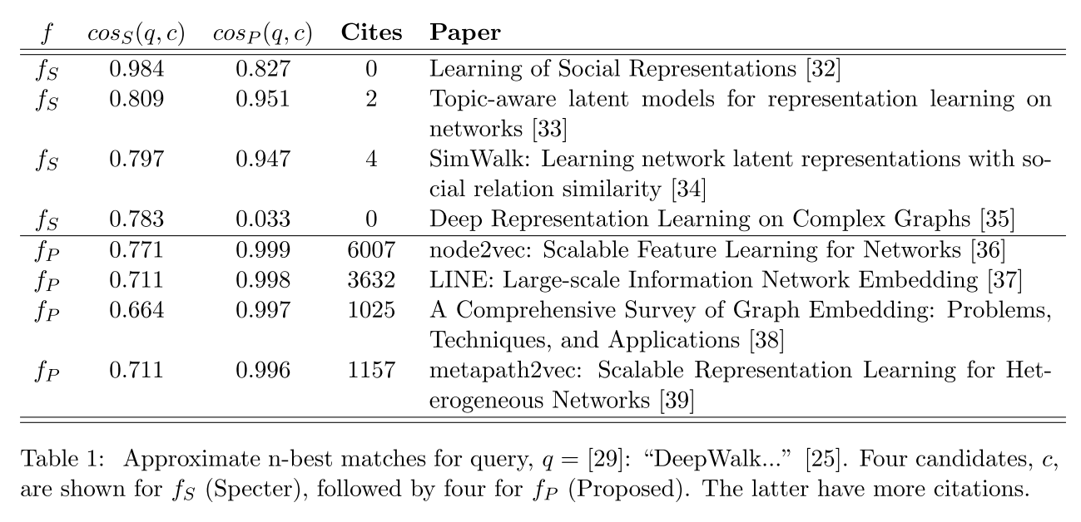
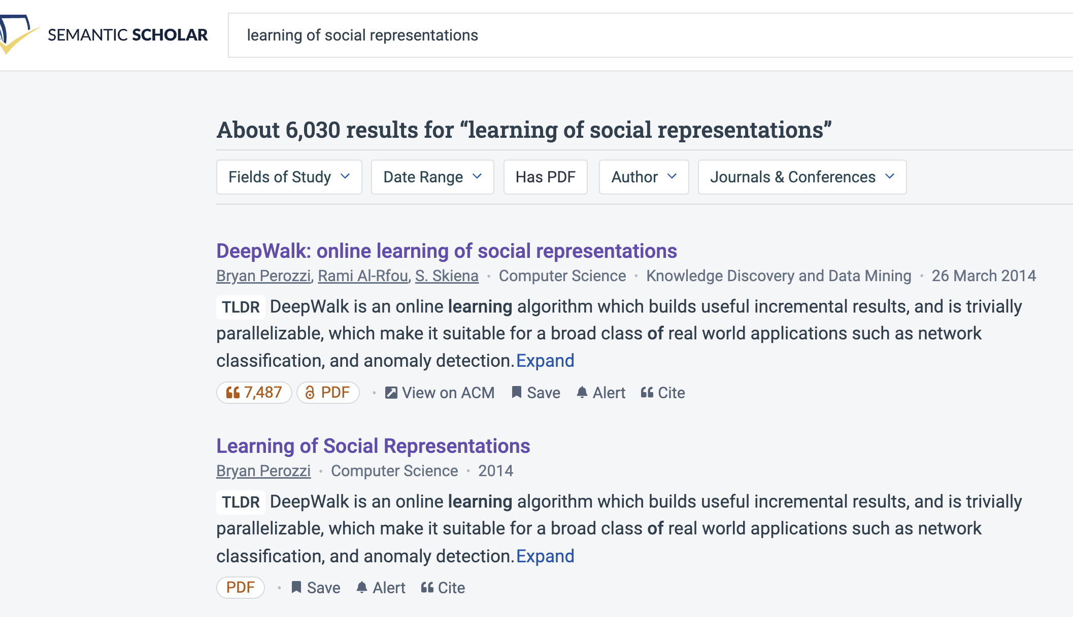
Query: ``DeepWalk: Online Learning of…’’

Slide 9
Document Similarities: Use Cases
Recommendations
What should I read?
What should I cite?
Many systems focus on ``relevance’’ (word overlap)
But we also want credibility
Don’t recommend papers that are buzz-word compliant
But not worth reading
(Most papers are never cited)

Slide 10
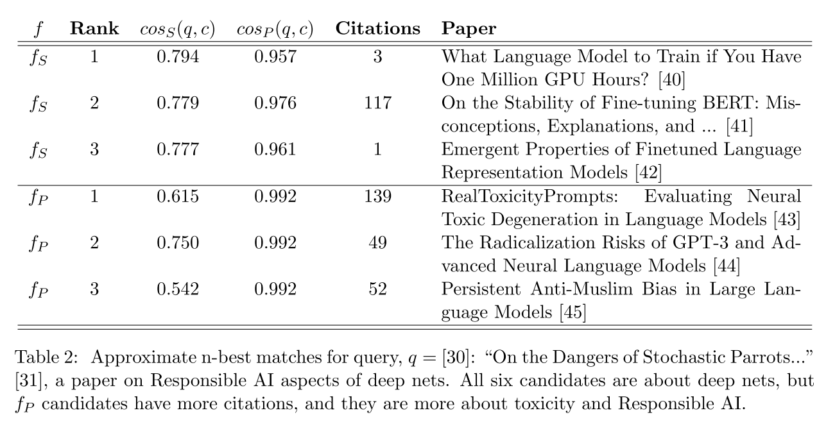
Query: ``On the Dangers of Stochastic Parrots…’’

Slide 11
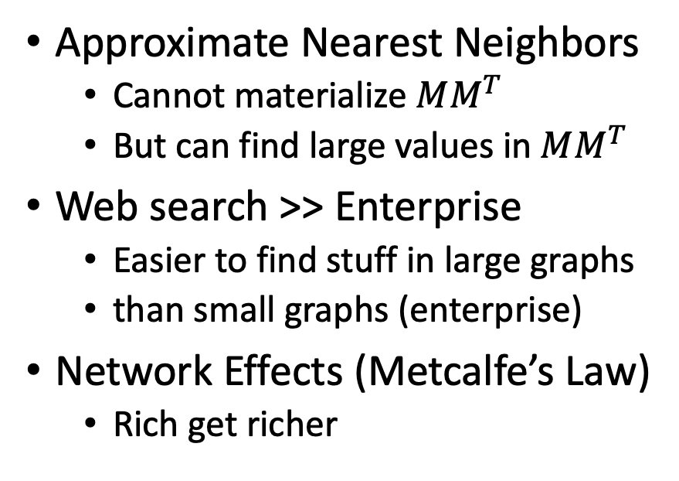
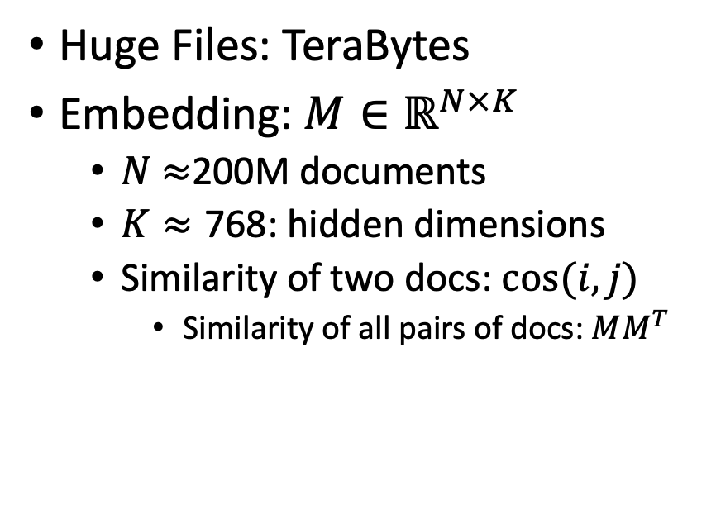
Scale: Both a Blessing and a Curse
Curse
Blessing
Huge Files: TeraBytes
Embedding: $M∈ℝ^{N×K}$
$N$ $≈$200M documents
$K≈\text{768}$: hidden dimensions
Similarity of two docs: $cos(i,j)⁡$
Similarity of all pairs of docs: $MM^{T}$
Approximate Nearest Neighbors
Cannot materialize $MM^{T}$
But can find large values in $MM^{T}$
Web search >> Enterprise
Easier to find stuff in large graphs
than small graphs (enterprise)
Network Effects (Metcalfe’s Law)
Rich get richer

Slide 12


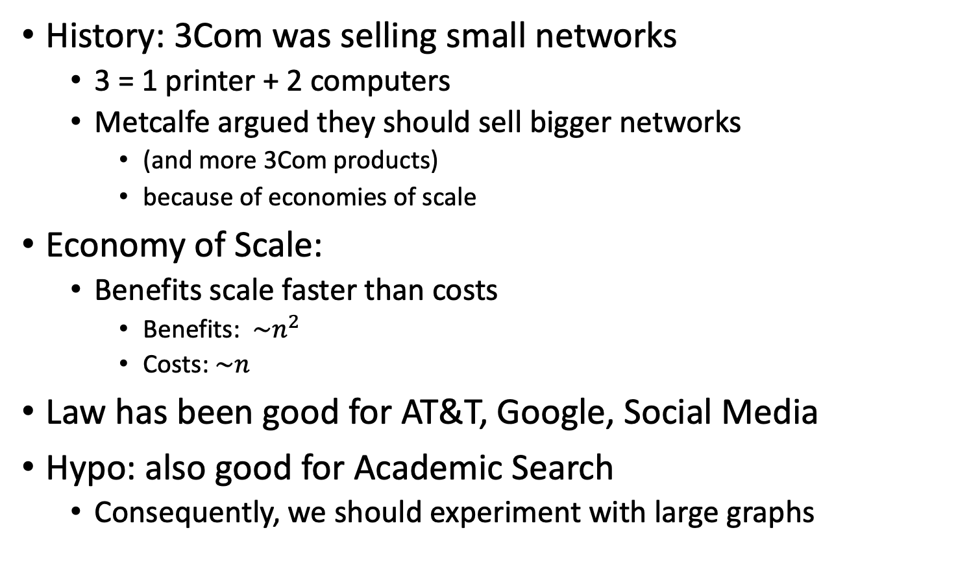
Metcalfe’s Law (Network Effects)
History: 3Com was selling small networks
3 = 1 printer + 2 computers
Metcalfe argued they should sell bigger networks
(and more 3Com products)
because of economies of scale
Economy of Scale:
Benefits scale faster than costs
Benefits: $\sim n^{2}$
Costs:$\sim n$
Law has been good for AT&T, Google, Social Media
Hypo: also good for Academic Search
Consequently, we should experiment with large graphs

Slide 13
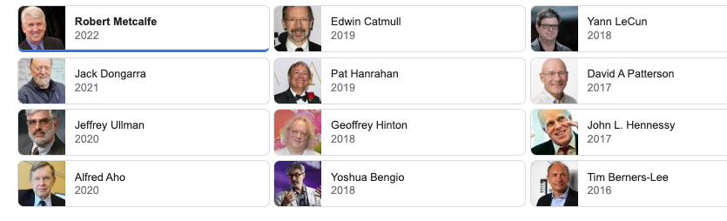
Turing Award/Winners

Slide 14
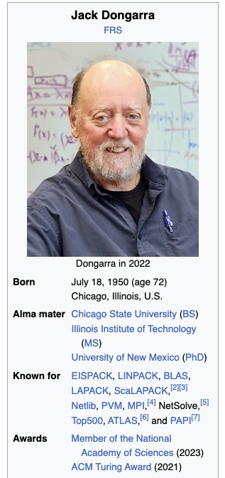
Turing Awards: Metcalfe’s Law, Deep Nets, Linear Algebra
Metclalfe’s Law: Metcalfe
Deep Nets: Hinton, Bengio, LeCun
Linear Algebra: Dongarra

Slide 15
Realities
The Real World
Idealizations (Evaluation Benchmarks)
Large (Metcalfe’s Law)
Growing
Dirty
Missing Values
Bad/misleading Values (dups)
Small
Static
Clean

Slide 16
Global Scientific Output Doubles Every 9 Years
Timeliness
Web companies keep indexes up to date (web is a moving target)
Ditto for Academic Search

Slide 17
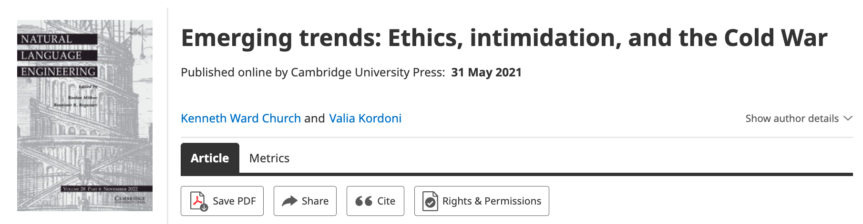
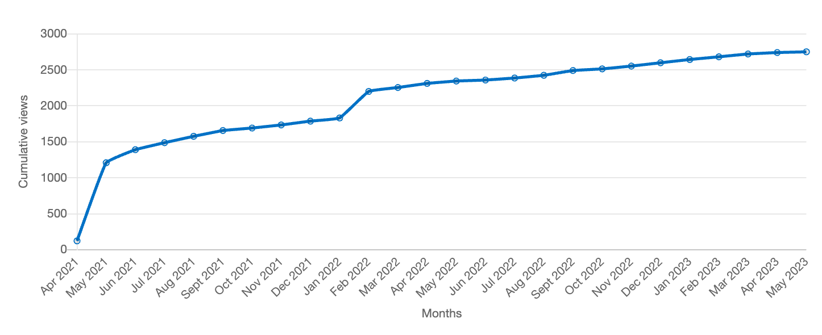
Value: Author Contributions + Audience Appreciation (Literature is a conversation, like social media)
Author Contributions
Time Invariant
Does not change after publication
Audience Appreciation
Evolves over time
Behavioral Signals
Views
Citations

Slide 18
The Impact of Large Language Models (LLMs) on MT: A European view
Kenneth Church
k.church@northeastern.edu
EAMT-2023
Video Recording

Slide 19
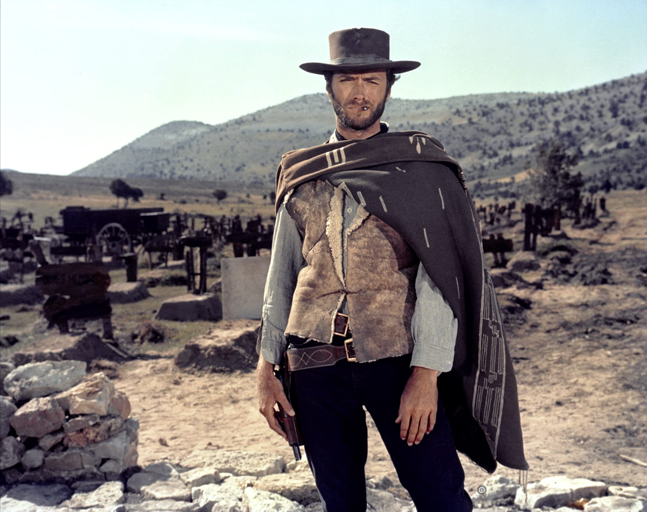
Disclaimer from an Ugly American… (The Good, the Bad and the Ugly)
This meeting reminds me of a meeting in Paris in 1995
Comparing NLP funding in America with European Community
America: funding → defense
Europe: funding → community
At that time, there were concerns about web
Would WWW be bad for French?
In retrospect,
Web has been good for languages, big and small
In general,
Technology → Change (for better and for worse)
Tech has upsides and downsides (and worse)

Slide 20

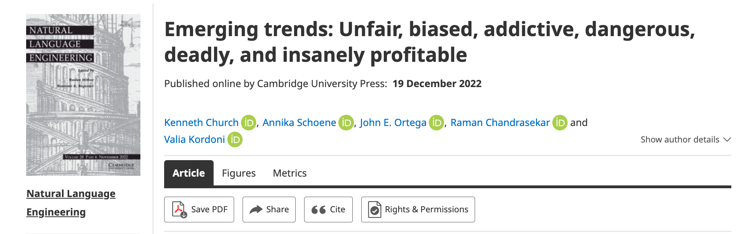
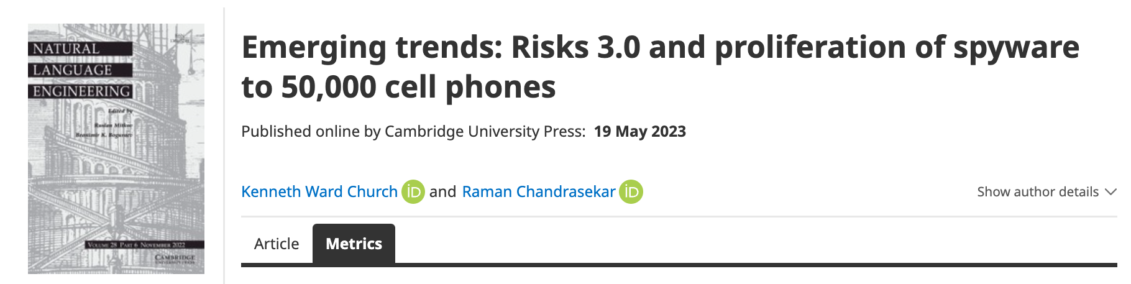
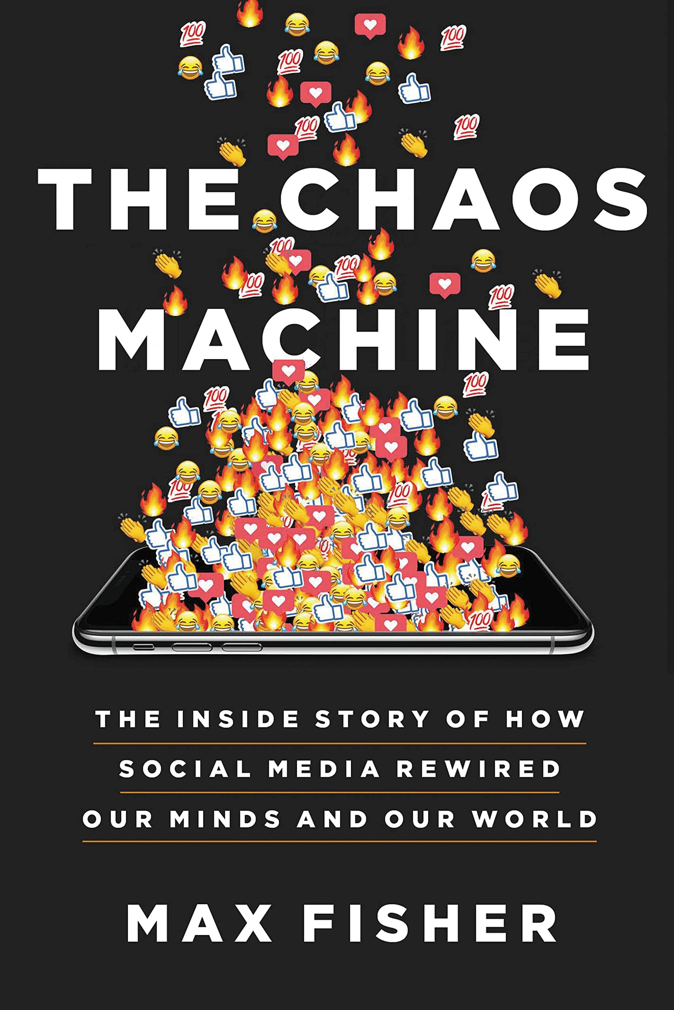



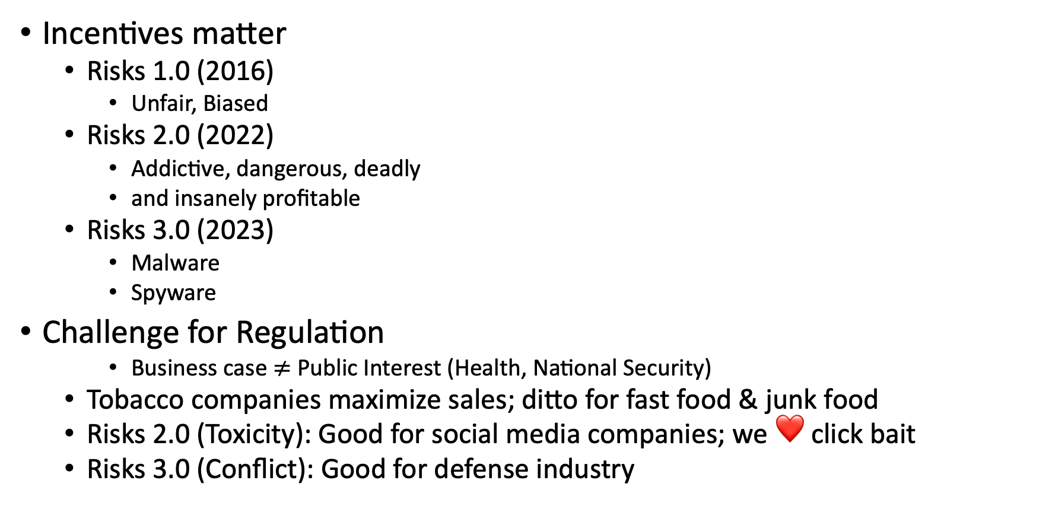
Ugly: Responsible AI
Incentives matter
Risks 1.0 (2016)
Unfair, Biased
Risks 2.0 (2022)
Addictive, dangerous, deadly
and insanely profitable
Risks 3.0 (2023)
Malware
Spyware
Challenge for Regulation
Business case $≠$ Public Interest (Health, National Security)
Tobacco companies maximize sales; ditto for fast food & junk food
Risks 2.0 (Toxicity): Good for social media companies; we ❤️ click bait
Risks 3.0 (Conflict): Good for defense industry

Slide 21
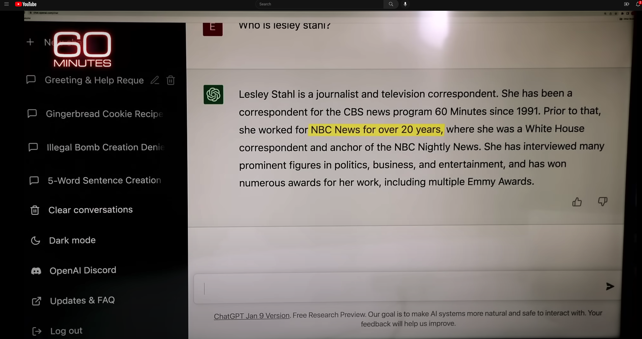
Hallucinations
Prompt
Language models
make up ``alternative facts’’
faster than fact-checking
Dangerous failure mode
People will believe these ``alternative facts’’
Hallucination
ChatGPT Hallucinates on CBS ``60 Minutes’’ https://www.youtube.com/watch?v=1wzPr4cUoMQ&t=463s
https://github.com/kwchurch/ACL2022_deepnets_tutorial
21

Slide 22
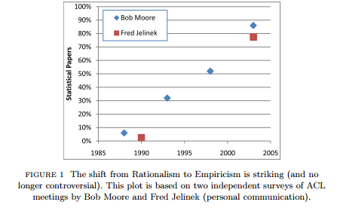
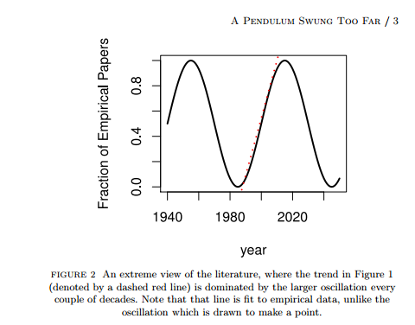
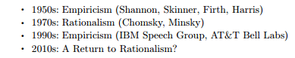
History: Pendulum Swung Too Far
⚠️ ⚠️ ⚠️ Warning ⚠️ ⚠️ ⚠️
Unrealistic Expectations → Winter
Mechanism
⚠️ ⚠️ ⚠️ Warning ⚠️ ⚠️ ⚠️
Unrealistic Expectations → Winter

Slide 23
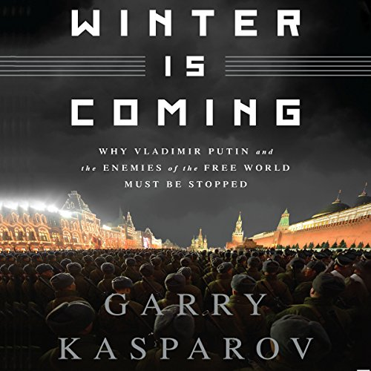
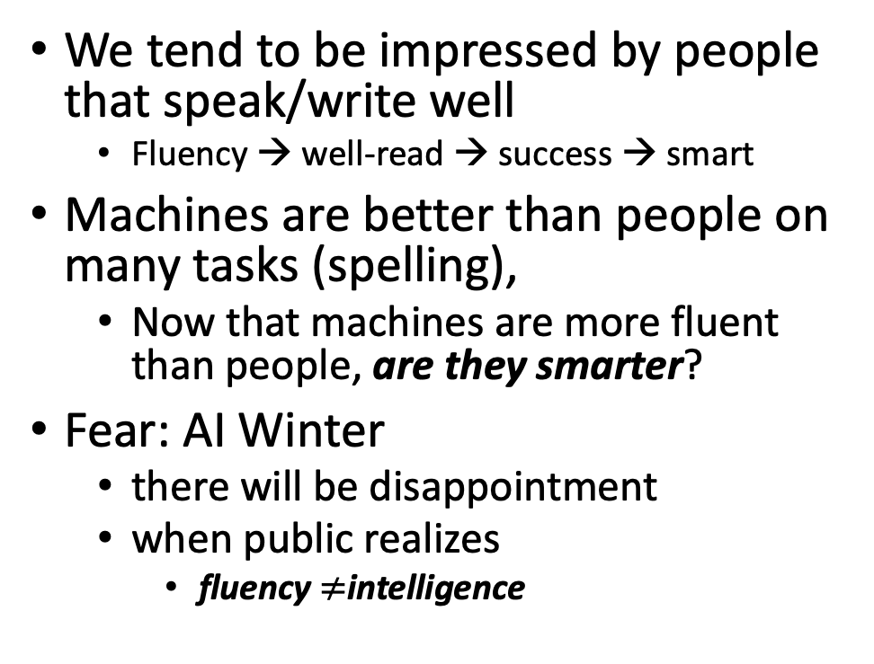
Winter is Coming
We tend to be impressed by people that speak/write well
Fluency → well-read → success → smart
Machines are better than people on many tasks (spelling),
Now that machines are more fluent than people, are they smarter?
Fear: AI Winter
there will be disappointment
when public realizes
fluency $≠$intelligence
Pendulum Swung Too Far
There have been many AI Winters
Often, after ``irrational exuberance’’
(like current excitement with nets)

Slide 24
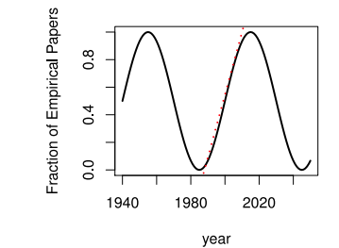
Large Language Models (LLMs) Strengths (1950s/1990s); Weaknesses (1970s)
Easy
Easy
Strengths (fluency)
1950s/1990s: Empiricism
Shannon, Skinner, Firth, Harris
You shall know a word by the company it keeps (Firth, 1957)
Collocations (Easy for Machines)
Distributional Hypothesis (Zellig Harris):
PMI, Word2Vec, BERT
No ``hard’’ stuff
Weaknesses (Hallucinations)
1970s: Rationalism (``Hard’’ Stuff)
Chomsky, Minsky
Truth: logic, possible worlds
Meaning
Purpose (Gricean Maxims)
Common Sense
Hard

Slide 25
Positive Opportunities for Machine Translation
Technology is good enough
that I could work for Baidu
even though my Chinese
is worse than my French
Functionality
Inputs: language → phones
camera, microphone, QR codes, net
documents (html, pdf, ppt, xls)
Outputs: phones → language
screen, speaker, net, etc.
Requirements: fluency, credibility, latency
Widely deployed (in China)
Everywhere: Hotels, taxis, shops, etc.
Anyone with a phone (everyone)
Knows how to use this stuff
Metrics suggest
Technology is better than humans
But I am more productive
with a human interpreter
Metrics are wrong: BLEU & latency
Human interpreters emphasize
What I need to know
When I need to know it
Machines translate
Everything (with equal emphasis)
I don’t trust machines (with terminology):
``ecology’’ vs ``eco-system’’
``corruption’’
It is exhausting second-guessing machines

Slide 26
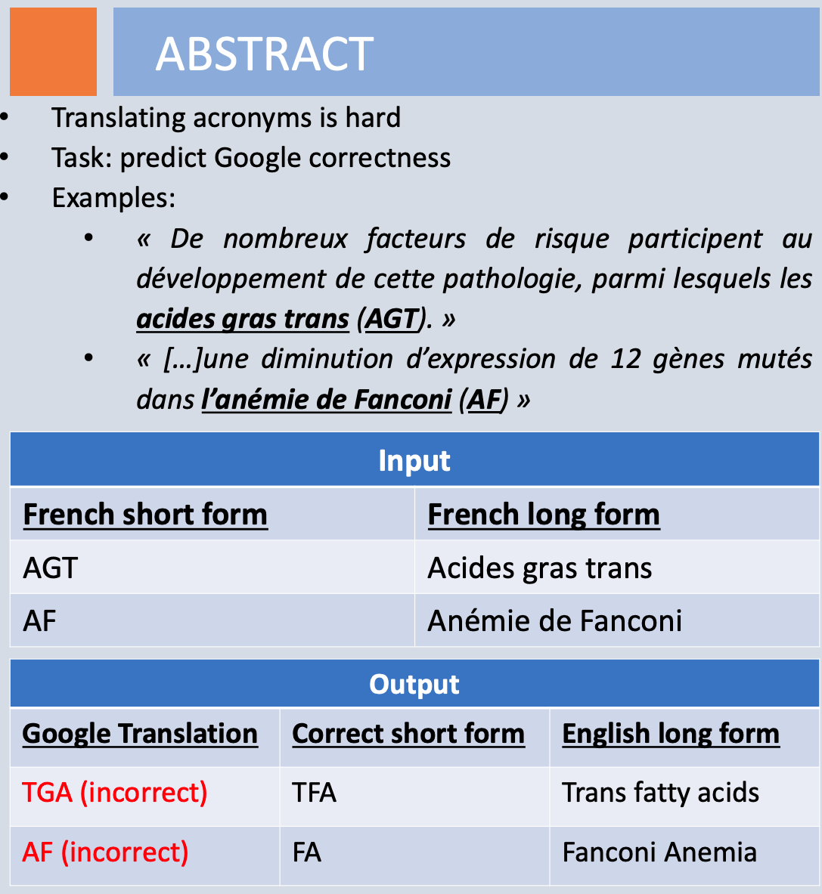
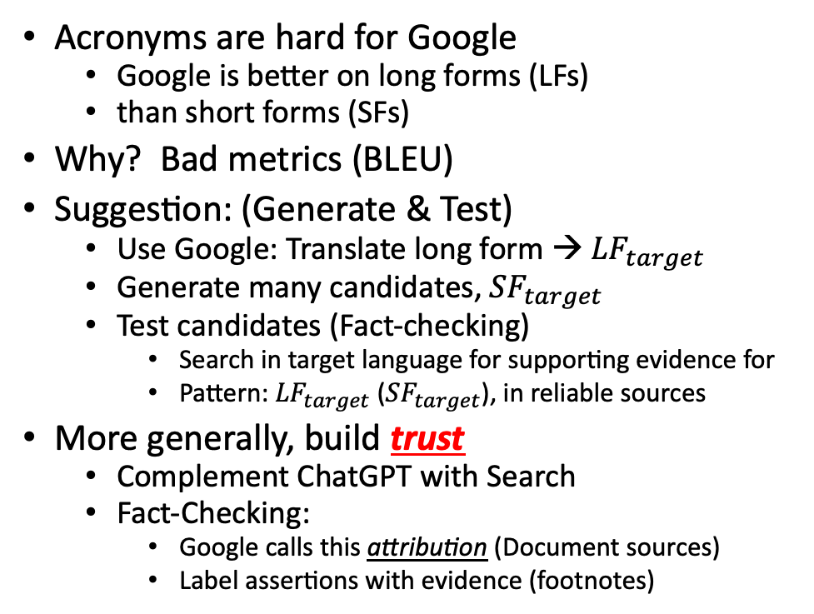
Mismatch Between Translators & Engineers: Technical Terminology
Richard Yue
Acronyms are hard for Google
Google is better on long forms (LFs)
than short forms (SFs)
Why? Bad metrics (BLEU)
Suggestion: (Generate & Test)
Use Google: Translate long form → ${LF}_{target}$
Generate many candidates, ${SF}_{target}$
Test candidates (Fact-checking)
Search in target language for supporting evidence for
Pattern: ${LF}_{target}$ (${SF}_{target}$), in reliable sources
More generally, build trust
Complement ChatGPT with Search
Fact-Checking:
Google calls this attribution (Document sources)
Label assertions with evidence (footnotes)

